Slide 1
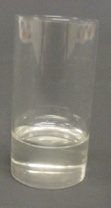
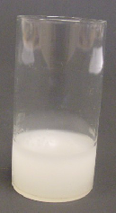
Cooling observations
Candles are made from wax.
When wax is very hot it is a liquid.
As liquid wax cools it can solidify and turn into a solid.
Cooling
Wax at 75ºC
Wax after cooling

Slide 2
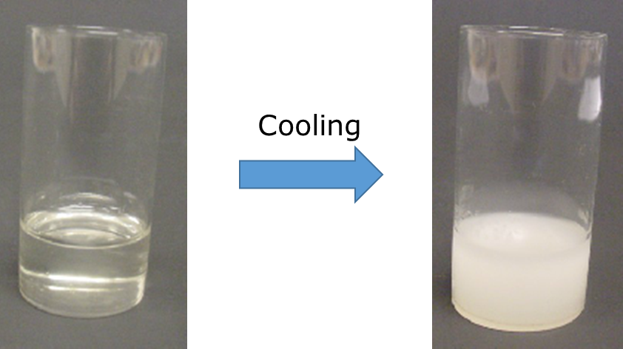
Cooling observations
The melting point of wax is 67ºC.
1. At what temperature does wax start to solidify?
A
69ºC
B
67ºC
C
65ºC
D
About 40ºC

Slide 3
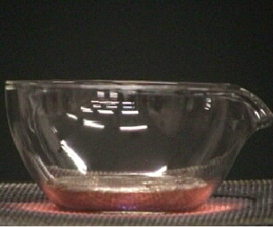
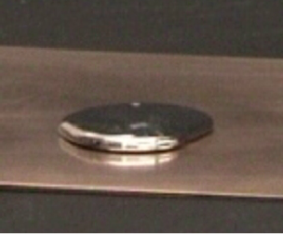
Cooling observations
Lead is a type of metal.
When lead is very hot it is a liquid.
As liquid lead cools it can solidify and turn into a solid.
Cooling
Lead is liquid at 350ºC
Lead turns solid after cooling

Slide 4
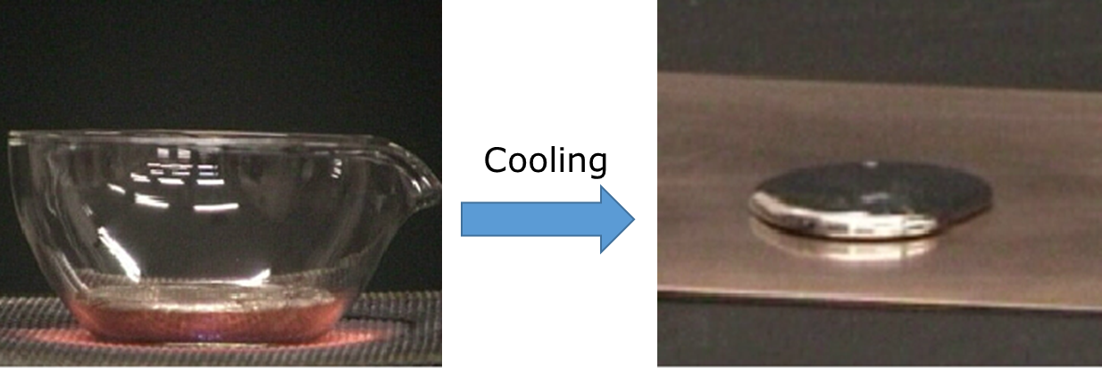
Cooling observations
The liquid lead starts to solidify at 327ºC.
2. What is the temperature of lead when the last bit has turned solid?
A
327ºC
B
326ºC
C
325ºC
D
Around 320ºC

